Slide 1
Unit II : Structuring the Data, Computations and Program
Elementary Data Types :Primitive data Types, Character String types, User Defined Ordinal Types, Array types, Associative Arrays, Record Types, Union Types, Pointer and reference Type.
Expression and Assignment Statements: Arithmetic expression, Overloaded Operators, Type conversions, Relational and Boolean Expressions, Short Circuit Evaluation, Assignment Statements, Mixed mode Assignment. Statement level Control Statements: Selection Statements, Iterative Statements, Unconditional Branching. Subprograms: Fundamentals of Sub Programs, Design Issues for Subprograms, Local referencing Environments, Parameter passing methods.
Abstract Data Types and Encapsulation Construct: Design issues for Abstraction, Parameterized Abstract Data types, Encapsulation Constructs, Naming Encapsulations.

Slide 2
Course Outcome
Design a program with Data representation and Computations

Slide 3
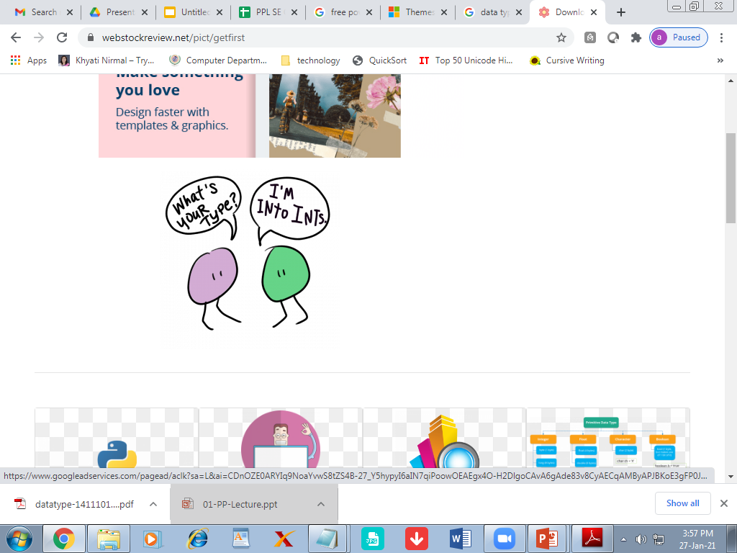
Data type: A data type defines a collection of data values and
a set of predefined operations on those values

Slide 4
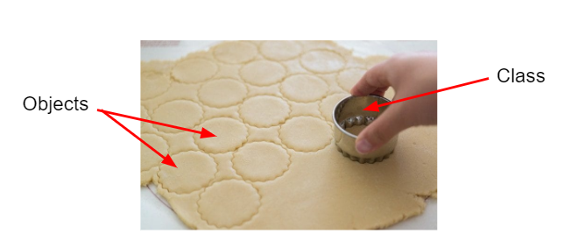
An object represents an instance of a user-defined (abstract data) type

Slide 5
Descriptor
A descriptor is the collection of the attributes of a variable.
In an implementation a descriptor is a collection of memory cells that store variable attributes.
If the attributes are static, descriptor are required only at compile time.
For dynamic attributes, part or all of the descriptor must be maintained during execution.
Descriptors are used for type checking and by allocation and deallocation operations.

Slide 6
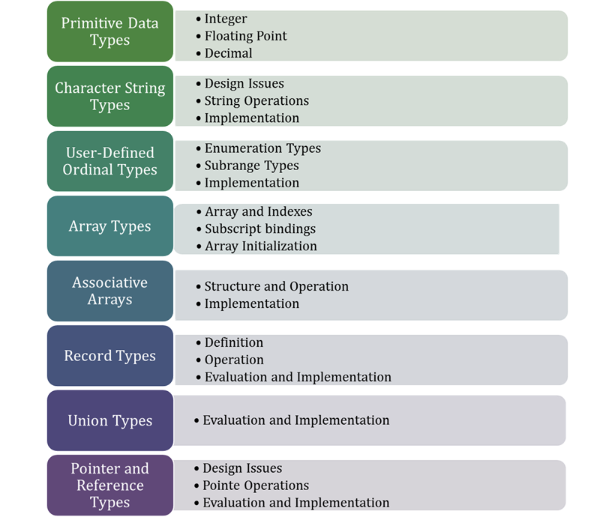
Data Types

Slide 7
Primitive Data Types

Slide 8
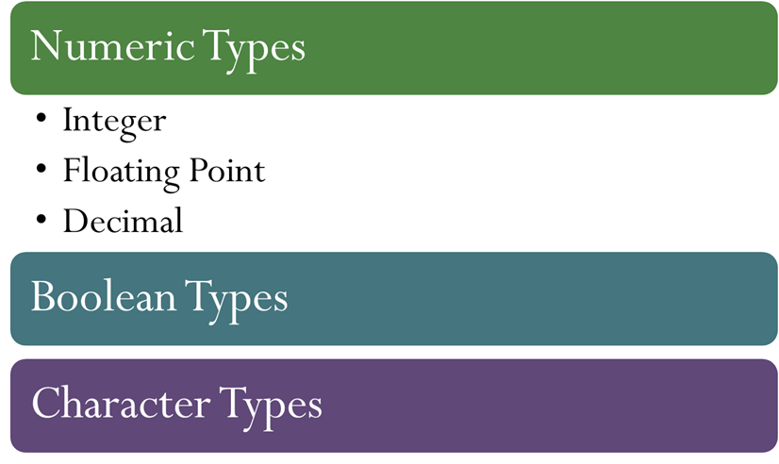
Primitive Data Types
Primitive data types are those that are not defined in terms of other data types

Slide 9
C++ type structure
Fundamental types
Derived Types
Integer
Float
Arrays
Class
Struct
Union
Pointer
Int
Char
Short
Long
Float
Double

Slide 10
Java type structure
Builtin
Composite
Integer
Float
Arrays
Class
Interface
Int
Char
Short
Long
Float
Double
Byte

Slide 11
Character String Types
A character strings type is one in which values are sequence of characters

Slide 12
Design issues
Is it a primitive type or just a special kind of character array
Is the length of objects static or dynamic

Slide 13
Implementation of character String type
Static Length Strings
Limited Dynamic length
Dynamic Length strings

Slide 14
Used Defined Ordinal Types

Slide 15
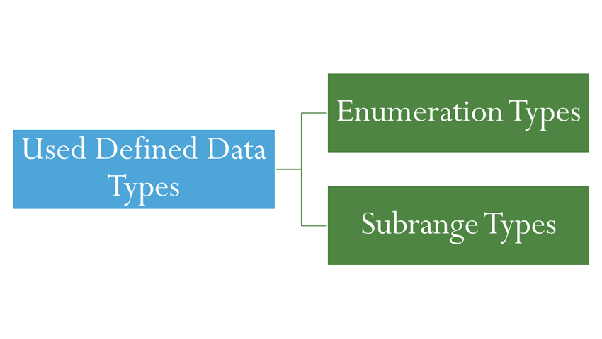
An ordinal type is one in which the range of possible values can be easily associated with the set of positive integers

Slide 16
Enumeration Types
In C++, we could have
enum colors {red, blue, green, yellow, black};
colors myColor = blue, yourColor = red;
E.g. myColor++ would assign green to myColor.
In languages that do not have enumeration types, programmers usually simulate them with integer values.
E.g. Fortran 77, use 0 to represent blue and 1 to represent red:
INTEGER RED, BLUE
DATA RED, BLUE/0,1/

Slide 17
Enumeration Types
Java Example Enumeration days; Vector dayNames = new Vector(); dayNames.add("Monday"); … dayNames.add("Friday"); days = dayNames.elements(); while (days.hasMoreElements()) System.out.println(days.nextElement());

Slide 18
Design issues for Enumeration Types
Is an enumeration constant allowed to appear more than one type definition?
If enumeration constant appear in more than one type definition, then how the type of an occurrence of that constant is checked?
Are enumeration values coerced to integer?
Any other type coerced to an enumeration?

Slide 19
All these design issues are related to type checking.
If an enum variable is coerced to a numeric type, there is little control over its range of legal operations or its range of values.
If an int type value is coerced to an enum type, an enum type variable could be assigned any integer value, whether it represented an enum constant or not

Slide 20
Evaluation of Enumerated Type
Aid to readability, e.g., no need to code a color as a number
Aid to reliability, e.g., compiler can check:
operations (don’t allow colors to be added)
No enumeration variable can be assigned a value outside its defined range
Ada, C#, and Java 5.0 provide better support for enumeration than C++ because enumeration type variables in these languages are not coerced into integer types

Slide 21
Subrange Type
An ordered contiguous subsequence of an ordinal type
Not a new type, but a restricted existing type
Example: 12..18 is a subrange of integer type
Ada’s design
type Days is (mon, tue, wed, thu, fri, sat, sun);
subtype Weekdays is Days range mon..fri;
subtype Index is Integer range 1..100;

Slide 22
An ordered contiguous subsequence of an ordinal type
Example: 12..18 is a subrange of integer type
•Ada’s design
type Days is (mon, tue, wed, thu, fri, sat, sun);
subtype Weekdays is Days range mon..fri;
subtype Index is Integer range 1..100;
Day1: Days;
Day2: Weekdays;
Day2 := Day1; - Assignment is legal unless Day1 = sat/sun

Slide 23
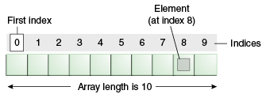
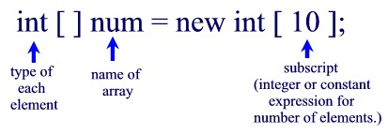
Array Type
An array is an aggregate of homogeneous data elements in which an individual element is identified by its position in the aggregate, relative to the first element.

Slide 24
Array Initialization
Some language allow initialization at the time of storage allocation
Fortran
List (3) Data List /0, 5, 5/ // List is initialized to the values
C, C++, Java, C# example
int list [] = {4, 5, 7, 83}
Character strings in C and C++
char name [] = “freddie”; // eight elements, including last element as null character
Arrays of strings in C and C++
char *names [] = {“Bob”, “Jake”, “Joe”];
Java initialization of String objects
String[] names = {“Bob”, “Jake”, “Joe”};
Ada positions for the values can be specified:
List : array (1..5) of Integer := (1, 3, 5, 7, 9);

Slide 25


Associative Array

Slide 26
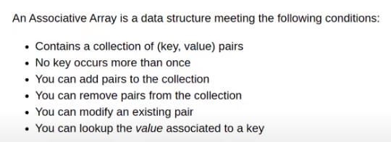
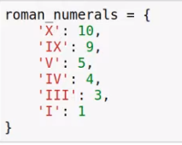
Associative Array
An associative array is an unordered collection of data elements that are indexed by an equal number of values called keys.
• So each element of an associative array is in fact a pair of entities, a key and a value.
• Associative arrays are supported by the standard class libraries of Java, C++, C#
• Example: In Perl, associative arrays are often called hashes. Names begin with %; literals are delimited by parentheses. Hashes can be set to literal values with assignment statement, as in
%salaries = (“Gary” => 75000, “Perry” => 57000,
“Mary” => 55750, “Cedric” => 47850);
Dictionary in Python

Slide 27
Python’s associative arrays, which are called dictionaries, are similar to those of Perl, except the values are all reference to objects.
• PHP’s arrays are both normal arrays and associative array.
• A Lua table is an associate array in which both the keys and the values can by any type.
• C# and F# support associative arrays through a .NET class.

Slide 28
Arrays
The individual data elements of an array are of the same type.
References to individual array elements are specified using subscription expressions.
If any of the subscript expressions in a reference include variables, then the reference will require an addition run-time calculation to determine the address of the memory location being referenced.

Slide 29
Design Issues in Arrays
The primary design issues specific to arrays are the following:
– What types are legal for subscripts? (int)
– Are subscripting expressions in element references range checked? (yes)
– When are subscript ranges bound?(statically bound, dynamically bound)
– When does allocation take place?
– Are ragged or rectangular multidimensional arrays allowed, or both?
– Can arrays be initialized when they have their storage allocated?
– What kinds of slices are allowed, if any?

Slide 30
Array and Indexes
Indexing (or subscripting) is a mapping from indices to elements.
• The mapping can be shown as:
array_name (index_value_list) → an element
• Ex, Ada assignment statement:
Sum := Sum + B(I);
– Because ( ) are used for both subprogram parameters and array subscripts in Ada, this results in reduced readability.
• C-based languages use [ ] to delimit array indices.
• Two distinct types are involved in an array type:
– The element type, and
– The type of the subscripts.

Slide 31
The type of the subscript is often a sub-range of integers.
• Among contemporary languages, C, C++, Perl, and Fortran don’t specify range checking of subscripts, but Java, ML, and C# do.
• In Perl, all arrays begin with at sign (@), because array elements are always scalars and the names of scalars always being with dollar signs ($), references to array elements use dollar signs rather that at signs in their names. For example, for the @list, the second element is referenced with $list[1].

Slide 32
Subscript Bindings and Array Categories
The binding of subscript type to an array variable is usually static, but the subscript value ranges are sometimes dynamically bound.
• In C-based languages, the lower bound of all index ranges is fixed at 0; Fortran 95, it defaults to 1.
• There are four categories of arrays, based on the binding to subscript ranges, the binding to storage, and rom where the storage is allocated.

Slide 33
A static array is one in which the subscript ranges are statically bound and storage allocation is static (done before run time).
– Advantages: efficiency “No allocation & deallocation.”
– Ex:
Arrays declared in C & C++ function that includes the static modifier are static.

Slide 34
A fixed stack-dynamic array is one in which the subscript ranges are statically bound, but the allocation is done at elaboration time during execution.
– Advantages: Space efficiency. A large array in one subprogram can use the same space as a large array in different subprograms.
– Ex:
Arrays declared in C & C++ function without the static modifier are fixed stack-dynamic arrays.

Slide 35
A fixed heap-dynamic array is similar to fixed stack-dynamic in which the subscript ranges are dynamically bound, and the storage allocation is dynamic, but they are both fixed after storage is allocated (i.e., binding is done when requested and storage is allocated from heap, not stack)
– The bindings are done when the user program requests them during execution, rather than at elaboration time and the storage is allocated on the heap, rather than the stack.
– Ex: ▪ C & C++ also provide fixed heap-dynamic arrays. The function malloc and free are used in C. The operations new and delete are used in C++. ▪ In Java, all non-generic arrays are fixed heap dynamic arrays. Once created, they keep the same subscript ranges and storage.

Slide 36
A heap-dynamic array is one in which the subscript ranges are dynamically bound, and the storage allocation is dynamic, and can change any number of times during the array’s lifetime.
– Advantages: Flexibility. Arrays can grow and shrink during program execution as the need for space changes.
– Ex: ▪ Objects of the C# List class are generic heap-dynamic arrays. These array object are created without any elements, as in
List<String> stringList = new List<Stirng>( );

Slide 37
▪ Java includes a generic class similar to C#’s List, named ArrayList.
▪ Perl, JavaScript, Python, and Ruby support heap-dynamic arrays. • A Perl array and JavaScript also support heap-dynamic array to grow with the push (puts one or more new elements on the end of the array) and unshift (puts one or more new elements on the beginning of the array)
• For example, in Perl we could create an array of five numbers with
Elements are added to this object with the Add method, as in
stringList.Add(“Michael”);
@list = {1, 2, 4, 7, 10);
Later, the array could be lengthened with the push function, as in
push(@list, 13, 17);
Now the array’s value is (1, 2, 4, 7, 10, 13, 17).

Slide 38
Slices
A slice of an array is some substructure of an array.
• It is a mechanism for referencing part of an array as a unit.
• If arrays cannot be manipulated as units in a language, that has no use for slices. Slices are only useful in languages that have array operations.
• Python – vector (3:6) is a three-element array, which is [8, 10, 12]
– mat[0][0:2] is the first and second element of the first row of mat, which is [1, 2]
– list.slice(2, 2) return returns the third and fourth elements of list: [6, 8]
– list.slice(1..3) return [4, 6, 8]
vector = [2, 4, 6, 8, 10, 12, 14, 16]
mat = [[1, 2, 3], [4, 5, 6], [7, 8, 9]]
• Ruby supports slices with the slice method
list = [2, 4, 6, 8, 10]

Slide 39
Evaluation
Arrays have been included in virtually all programming languages.
• The primary advances since their introduction in Fortran I have been slices and dynamic arrays.
• The latest advances in arrays have been in associate arrays

Slide 40
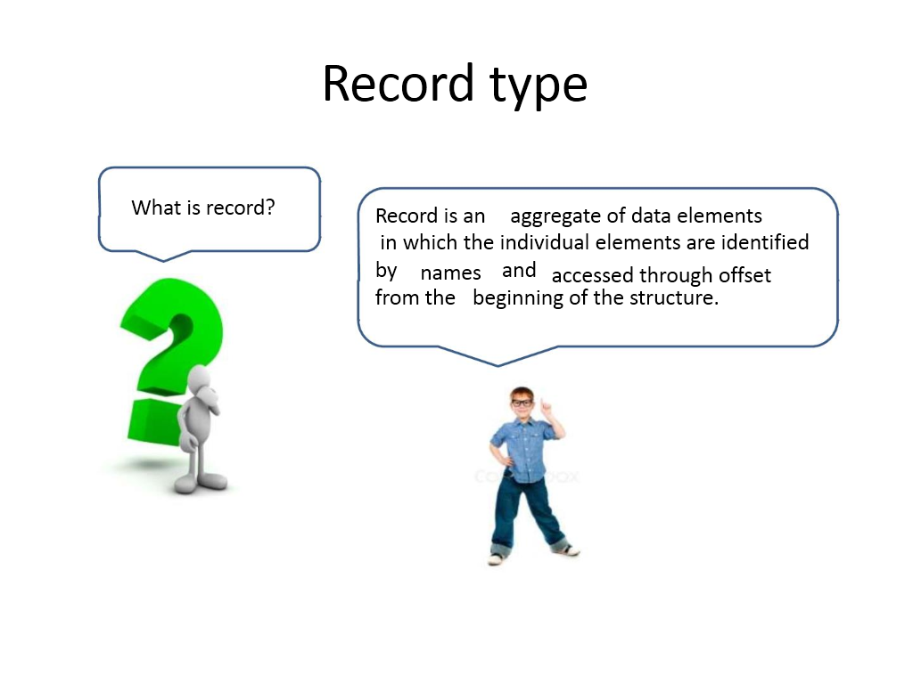
Record Type

Slide 41
A record is a possibly heterogeneous aggregate of data elements in which the individual elements are identified by names.
• In C, C++, and C#, records are supported with the struct data type. In C++, structures are a minor variation on classes.

Slide 42
Definitions of Records
The fundamental difference between a record and an array is that record elements, or fields, are not referenced by indices. Instead, the fields are named with identifier, and references to the fields are made using these identifiers.
A data structure which is collection of components of different data types is termed as record.
Specifications: The attributes of record are
1. The number of components
2. The data type of each component
3. The selector used to name each component.
In c the syntax for record is denoted by struct
struct student{
int rollno;
char name[20];
}

Slide 43
Evaluation
Records and arrays are closely related structural forms.
• Arrays are used when all the data values have the same type and/or are processed in the same way.
• Records are used when the collection data values is heterogeneous and the different fields are not processed in the same way. Also, the fields of a record often need not be processed in a particular order.
• Access to array elements is much slower than access to record fields, because subscripts are dynamic (field names are static)

Slide 44
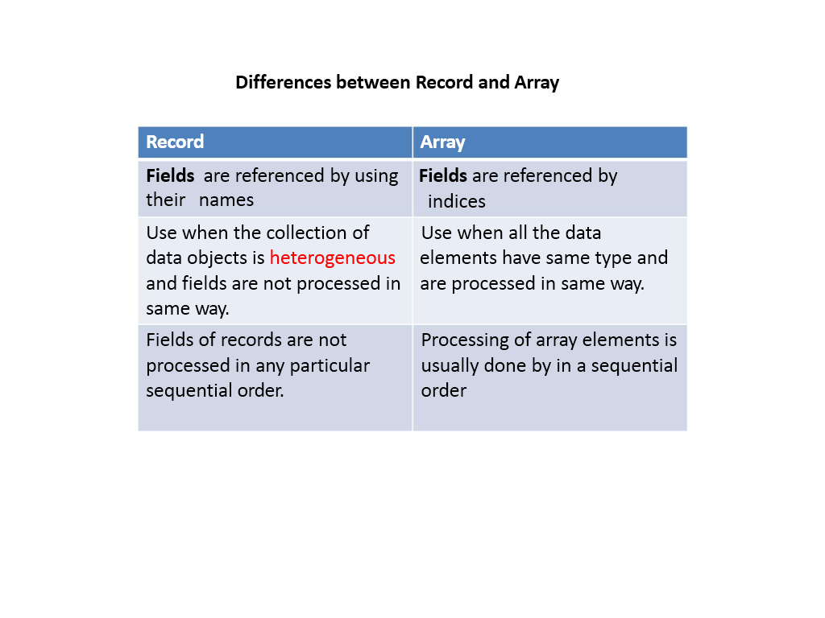
Record Type

Slide 45
Record Type
ADA:
type Emp_Rec_Type is record
First: String (1..20);
Mid: String (1..10);
Last: String (1..20);
Hourly_Rate: Float;
end record;
Emp_Rec: Emp_Rec_Type;
COBOL:
01 WS-DATE.
02 WS-YEAR PIC 9999.
02 WS-MONTH PIC 99.
02 WS-DAY PIC 99.
Array of Records
intArr = array of integer;
strArr = array of string;
recPerson = record
ForeName, SurName: string;
BirthDay: TDateTime;
Income: integer;
end;
arrPersons = array of recPerson;
Pascal:
type TDate = record
Year: Integer;
Month: 1..12;
Day: 1..31;
end;

Slide 46
Union
A union is a type whose variables are allowed to store different type values at different times during execution

Slide 47
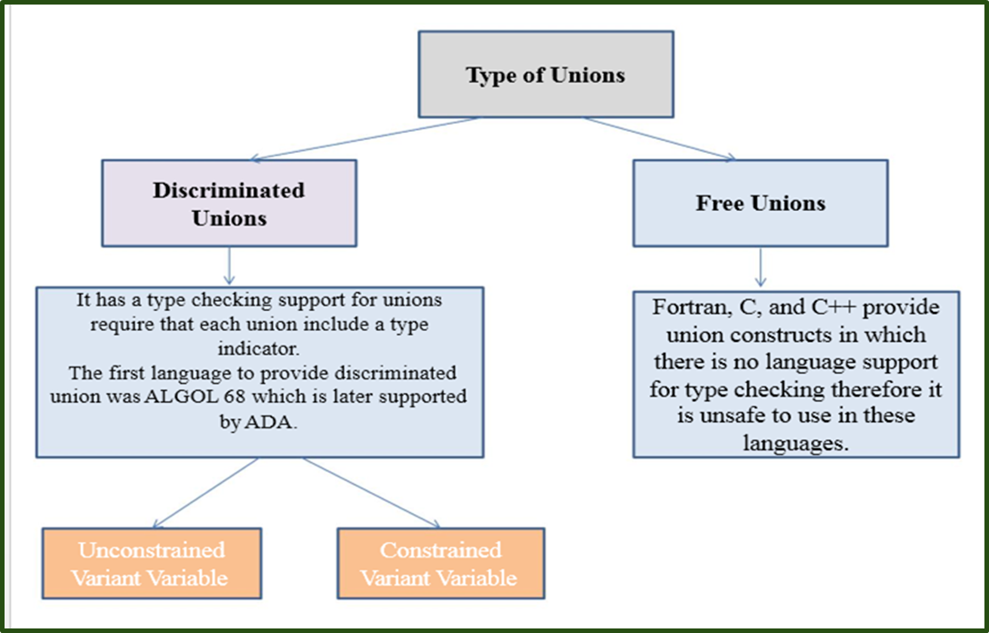
Types of Union

Slide 48
Evaluation
Potentially unsafe construct – They are one of the reasons why C and C++ are not strongly typed
• Java and C# do not support unions – Reflective of growing concerns for safety in programming language

Slide 49
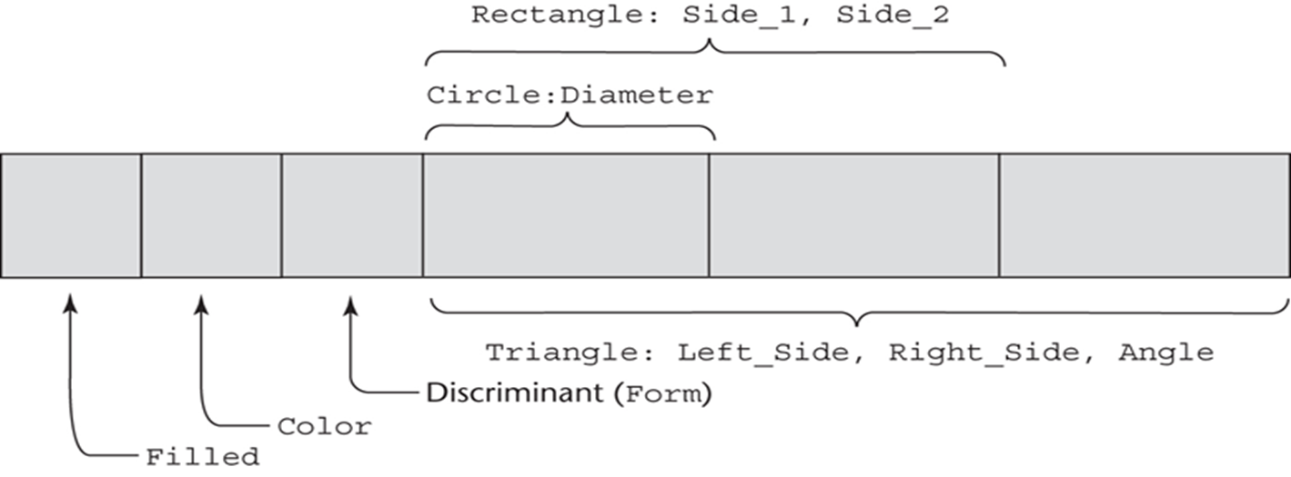
Union Example in ADA
type Shape is (Circle, Triangle, Rectangle);

Slide 50
Pointers and Reference Variable
A pointer type in which the variables have a range of values that consists of memory addresses and a special value, nil.
• The value nil is not a valid address and is used to indicate that a pointer cannot currently be used to reference any memory cell.
• Pointers are designed for two distinct kinds of uses: – Provide the power of indirect addressing
– Provide a way to manage dynamic memory. A pointer can be used to access a location in the area where storage is dynamically created (usually called a heap)

Slide 51
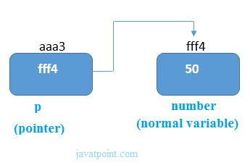
Pointers and Reference Variable
Pointer is a variable which stores the address of another variable
int number = 50;
int* p = &n;

Slide 52

#include <stdio.h>
int main()
{
int* pc, c;
c = 22;
printf("Address of c: %p\n", &c);
printf("Value of c: %d\n\n", c); // 22
pc = &c;
printf("Address of pointer pc: %p\n", pc);
printf("Content of pointer pc: %d\n\n", *pc); // 22
c = 11;
printf("Address of pointer pc: %p\n", pc);
printf("Content of pointer pc: %d\n\n", *pc); // 11
*pc = 2;
printf("Address of c: %p\n", &c);
printf("Value of c: %d\n\n", c); // 2
return 0;
}
pc = &c;
Address of c: 2686784
Value of c: 22
Address of pointer pc: 2686784
Content of pointer pc: 22
Address of pointer pc: 2686784
Content of pointer pc: 11
Address of c: 2686784
Value of c: 2

Slide 53
Design Issues of Pointer
What are the scope of and lifetime of a pointer variable?
What is the lifetime of a heap-dynamic variable?
Are pointers restricted as to the type of value to which they can point?
Are pointers used for dynamic storage management, indirect addressing, or both?
Should the language support pointer types, reference types, or both?

Slide 54
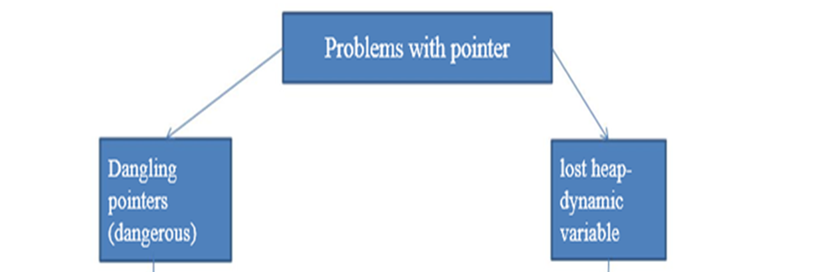

Slide 55
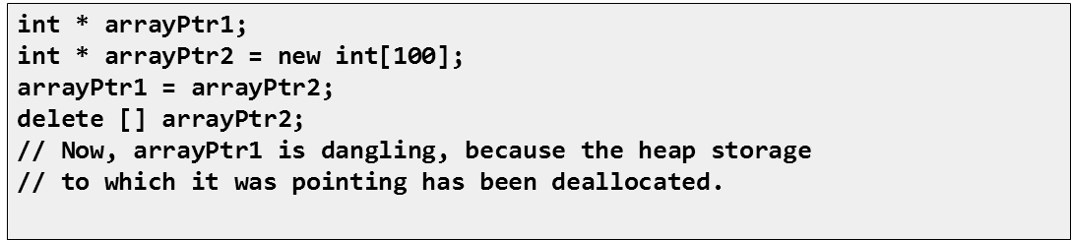
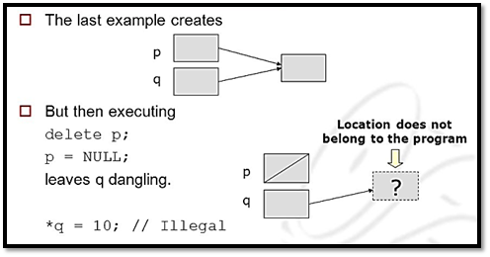
Dangling Pointer
Dangling pointers (dangerous)
A pointer points to a heap-dynamic variable that has been deallocated

Slide 56

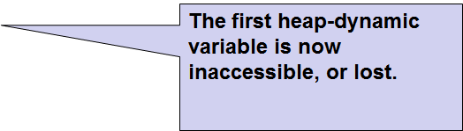
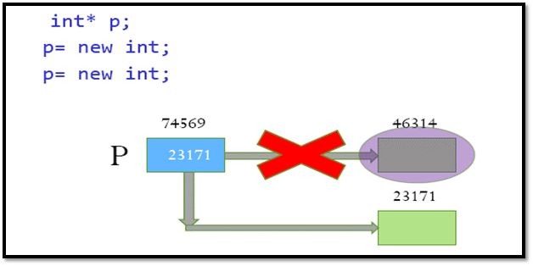
Lost Heap dynamic Variable

Slide 57
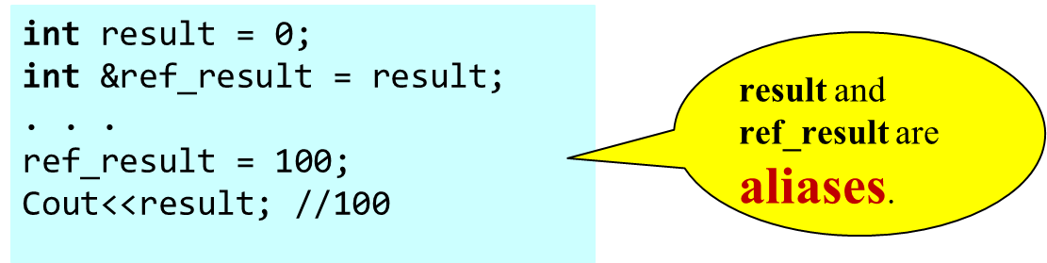
Reference Type
C++ includes a special kind of pointer type called a reference type that is used primarily for formal parameters
Advantages of both pass-by-reference and pass-by-value
Java extends C++’s reference variables and allows them to replace pointers entirely
References are references to objects, rather than being addresses
C# includes both the references of Java and the pointers of C++

